Slide 1

Project ZEMAP
Zero Emissions of Mercury in the Asia-Pacific

Slide 2
77%
Are UNAWARE of the presence and implications of consuming mercury

Slide 3
The Challenge¹
The Question: How can the UNEP GEF (Global Environment Facility) Chemicals and Waste unit assist developing countries in the Asia pacific region transition from Mercury emitting satellites by 2025?
Our Focus: Producing economically viable solutions that prioritise environmental sustainability and human health. These solutions concern phasing out mercury emissions and ensuring the well being of the stakeholders.

Slide 4






The Team
Samuel Wait
Engineering and Commerce
Facilitator
Karmanpreet Sukhija
Biomedical Science
Thinker
Carolyn Chhor
Biomedical Science
Organiser
Michael Zhang
Arts and Finance
Initiator
Ihsan Imran
Engineering
Leader
Marisha Perera
Commerce
Evaluator

Slide 5
Overview^{2,3}
Conferences to discuss framework
Fuel Alternatives
Problem: How can GEF (Global Environment Facility) assist developing countries in the Asia pacific region transition from Mercury emitting satellites by 2025?¹
Prototype
Website
Environment & Local Population
Stakeholders
Local Governments & Policy Makers
Mercury phased out as Satellite propellant
Sustainable Future
Satellite Companies & Industry
Sources of Mercury
Local Health Systems
Manufacturing Companies
Mining industry

Slide 6
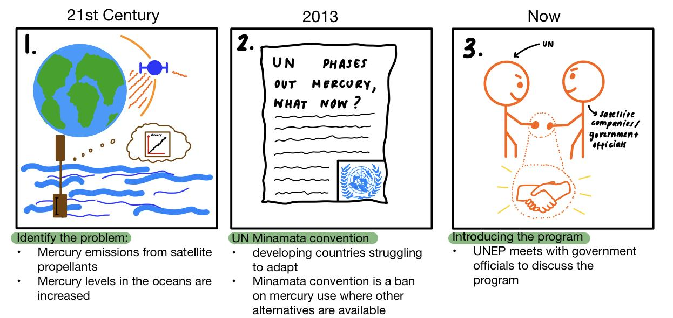
Storyboard^{4, 5, 6, 7, 8}

Slide 7
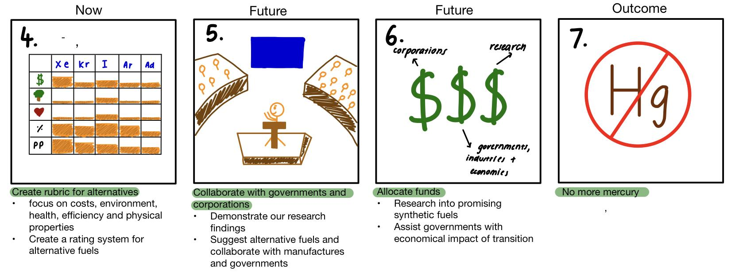

Slide 8
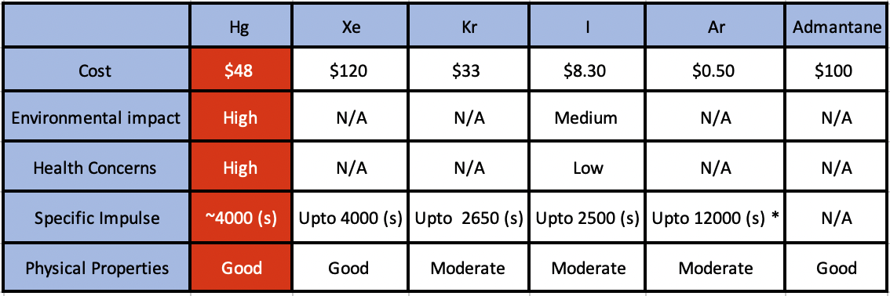
Initial Prototype^{9, 10, 11}
Best to least viable alternatives

Slide 9
Testing Insights^{12, 13, 14}
Soft Power
Inclusion
Collaboration

Slide 10
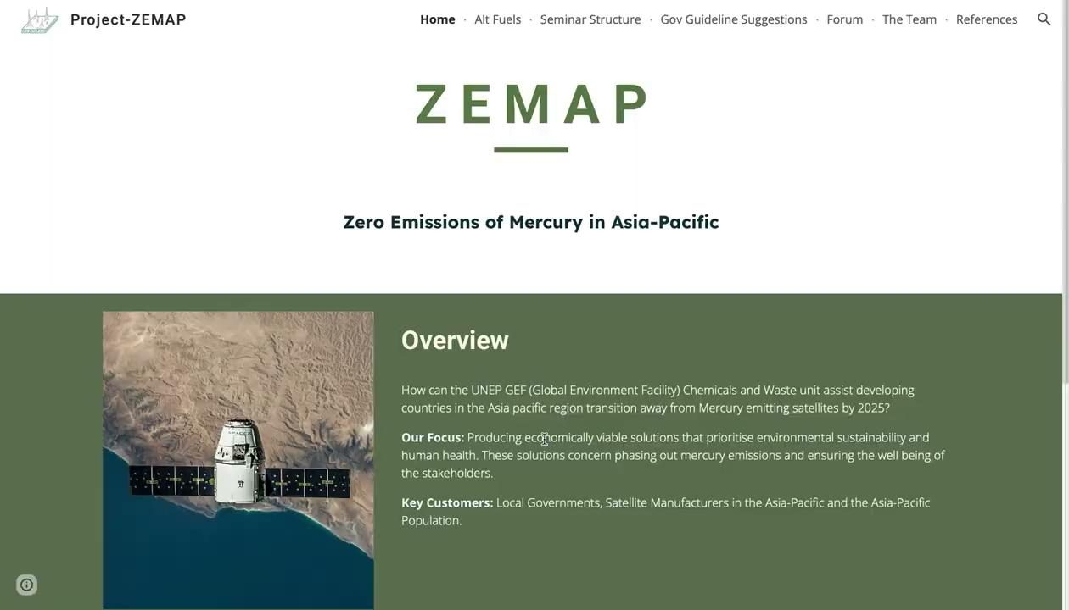
Website

Slide 11
Next Steps
UN Environment Programme collaborate with UN agencies such as UNOOSA (United Nations Office for Outer Space Affairs)
Plan the conference/seminar to discuss with governments guidelines to approach this issue
Discuss fuel alternative other than mercury with governments and satellite companies
Raise awareness of the environmental impact of mercury through social media channels

Slide 12

QR Code

Slide 13
References
Focus
UN Environment. Global Mercury Assessment 2018 [Internet]. Switzerland: Chemicals and Health Branch Geneva; 2019 [cited 2023 Jan 16]. 62. Available from: https://www.unep.org/resources/publication/global-mercury-assessment-2018?_ga=2.253802063.631252981.1673835842-2120649893.1673493201
Diagramming the the problem (2)
Jarrige J, Elias PQ, Cannat F, Packan D. Performance Comparison of an ECR Plasma Thruster Using Argon and Xenon as Propellant Gas. In: 33rd International Electric Propulsion Conference [Internet]; 2013 Oct 6-10; Washington DC. The George Washington University; 2013 [cited 2023 19 Jan]; p 1-12. Available from: http://electricrocket.org/IEPC/ck35023e.pdf
Fourie D, Hedgecock IM, Simone FD, Sunderland EM, Pirrone N. Are mercury emissions from satellite electric propulsion an environmental concern? Environ Res Lett [Internet]. 2019 [cited 2023 Jan 19];14(12). Available from: https://iopscience.iop.org/article/10.1088/1748-9326/ab4b75 doi: 10.1088/1748-9326/ab4b75
Sketches (2)
Fazio N, Gabriel SB, Golosnoy IG. Alternative propellants for gridded ion engines. In: Space Propulsion 2018 [Internet]; 2018 May 18. Southampton UK: University of Southampton; 2018 [cited 2023 Jan 19]; 1-9. Available from: https://www.researchgate.net/publication/326571233_Alternative_propellants_for_gridded_ion_engines
Richard D. Iodine as an alternative fuel for electric propulsion [Internet]. Tuscaloosa: The University of Alabama; 2016 [cited 2023 Jan 19]. 25. Available from: http://surveygizmoresponseuploads.s3.amazonaws.com/fileuploads/11364/363557/117-e9e6012ace7ca9871a14f9d9e77b60fe_Iodine%2Bas%2Ban%2BAlternative%2BFuel%2Bfor%2BElectric%2BPropulsion%2BFINAL.pdf

Slide 14
Storyboard (3)
6. Rawlin VK, Patterson MJ, Gruber RP. Xenon ion propulsion for orbit transfer. In: 21st International electric population conference by the AIAA, DGLR and JSASS; Orlando, Florida: Lewis Research Center; 1990 [cited 2023 Jan 19]; 1-28. Available from: https://www.researchgate.net/publication/24391189_Xenon_ion_propulsion_for_orbit_transfer doi: 10.2514/6.1990-2527
7. Funding [Internet]. Global environment facility. Who we are/Funding; 2023 [cited 2023 Jan 19]; [about 2 screens]/ Available from: https://www.thegef.org/who-we-are/funding
8. International Atomic Energy Agency. Separation, Storage and Disposal of of Krypton-85 [Internet]. Vienna, Austria; 1980 [cited 2023 Jan 19]. 81. Available from: https://inis.iaea.org/collection/NCLCollectionStore/_Public/11/569/11569296.pdf
Prototype (3)
9. Cuevas CA, Maffezzoli N, Corella JP, Spolaor A, Vallelonga P, Kjaer HA et al. Rapid increase in atmospheric iodine levels in the North Atlantic since the mid-20th century. Nat. Commun. 2018 Apr ;9:1452. Available from: https://www.nature.com/articles/s41467-018-03756-1 doi: 10.1038/s41467-018-03756-1
10. Patterson M. NASA - Ion Propulsion [Internet]. Cleveland Ohio: NASA Glenn Research Center; 2017 [updated 2017 Aug 7], cited 2023 Jan 19]. Available from: https://www.nasa.gov/centers/glenn/about/fs21grc.html
11. Beattle JR, Matossian JN. Mercury ion thruster technology. Malibu, CA: Hughes Research Labs; 2013 [cited 2023 Jan 19]. 156 p. Available from: https://ntrs.nasa.gov/citations/19890012463

Slide 15
Insights, Testing, Next Steps (2)
12. Nye JSJ. The soft power of the united nations. Project Syndicate. [Internet]. 2007 Nov 12 [cited 2023 Jan 25]; Politics:[1 page]. Available from: https://www.project-syndicate.org/commentary/the-soft-power-of-the-united-nations
13. Zhang Y, Song Z, Huang S, Zhang P, Peng Y, Wu P. Global health effects of future atmospheric mercury emissions. Nat commun [Internet]. 2021 [cited 2023 Jan 25];12. Available from: https://www.nature.com/articles/s41467-021-23391-7 doi: 10.1038/s41467-021-23391-7
14. United Nations Environment Programme. About UN environment programme [Internet]. Nairobi, Kenya, UNEP; 2023; [cited 2023 Jan 25]. Available from: ​​https://www.unep.org/about-un-environment

Slide 16
Questions?

